Slide 1


Slide 2
Weekly Updates
Please provide a quick update on either:
Something you did/saw this week that you thought was interesting
What you’re looking forward to about this week’s workshop
(Reminder - please have your cameras on if possible)

Slide 3
Workshop 7
Performance Evaluation

Slide 4

Recap

Slide 5
Sessions Overview
Workshop 1 – Project Introduction & Setup
Workshop 2 – Genomic Data (A2 Assignment)
Workshop 3 – Data Analysis & Visualization (A3 Assignment)
Workshop 4 – Featurization & Baseline Modeling (A4 Assignment)
Workshop 5 – Model Training Approaches (Final Assignment Set)
Workshop 6 – Model Tuning
Workshop 7 – Performance Evaluation (Final Assignment Code/Testing Due)
Workshop 8 – Results Presentation & Wrap up (Final Presentation Due)

Slide 6
The Data Science Process
Understand the Problem
Gather Data
Explore & Analyze Data
Repeat as needed:
Data Science is an iterative process
Featurize Data
Model Building
Evaluate and Compare
Present Results

Slide 7
Model Tuning & Comparison
Last week we took a single Random Forest model and reviewed different methods for optimizing performance
Methods:
Grid search
Random search
Bayesian Optimization
Nested Cross Validation
Method for parameter selection & model comparison
Higher complexity but fairer review across multiple held out datasets
Early stopping point
train
validate
Searching parameters

Slide 8
Evaluation Metrics

Slide 9

What is our Definition of Good?
Model Loss/Accuracy are the most common assessments
Loss is a continuous measurement of model fit
What do we care about?
Categorial targets
Binary S vs R
Why not just accuracy?
Remember our baseline models
Achieved ~80% accuracy with majority predictor
What have we used thus far?
Balanced accuracy
What does it actually mean and measure
Why is it better than standard accuracy?

Slide 10
Confusion - let’s use it
Predicted Class
A
B
C
D
2 | 5 | 10 | 3
0 | 20 | 8 | 1
4 | 4 | 30 | 7
1 | 5 | 8 | 11
A
Categorical predictions
Per class performance
Confusion Matrix is an natural visual representation
Rows = True class
Columns = Predicted class
For AMR Predictions:
Major errors
Very major errors
Very major errors are a worse outcome for patients
B
True Class
C
D
Predicted Class
S
R
55 | 11
5 | 23
S
S -> R = Major
True Class
R
R -> S = Very Major

Slide 11
Binary Assessments
Predicted Class
S
R
55 | 11
5 | 23
S
S -> R = Major
For AMR Predictions:
Major errors
Very major errors
In general we can think of this as Positive & Negative
Positive Predictions = R
Negative Prediction = S
Common Metrics:
Sensitivity
Specificity
Balanced accuracy = average of the above
True Class
R
R -> S = Very Major
Predicted Class
-
+
55 | 11
5 | 23
-
Sensitivity:
Fraction of Positive Class predicted as Positive
True Class
+
-
+
55 | 11
5 | 23
-
Specificity:
Fraction of Negative Class predicted as Negative
True Class
+

Slide 12
Binary Assessments
Baseline Majority Model
Predicted Class
For AMR Predictions:
Major errors
Very major errors
In general we can think of this as Positive & Negative
Positive Predictions = R
Negative Prediction = S
Common Metrics:
Sensitivity
Specificity
Balanced accuracy = average of the above
S
R
80 | 0
20 | 0
S
True Class
R
Accuracy = ???
Sensitivity = ???
Specificity = ???
Balanced accuracy = ???

Slide 13
Binary Assessments
Baseline Majority Model
Predicted Class
For AMR Predictions:
Major errors
Very major errors
In general we can think of this as Positive & Negative
Positive Predictions = R
Negative Prediction = S
Common Metrics:
Sensitivity
Specificity
Balanced accuracy = average of the above
S
R
80 | 0
20 | 0
S
True Class
R
Accuracy = 80 %
Sensitivity = 0 %
Specificity = 100 %
Balanced accuracy = 50 %

Slide 14
Uncertainty

Slide 15
QUIZ TIME !?
Why do we need to use statistical uncertainty?
To add a touch of mystery and suspense to our data analysis.
To make more accurate predictions on future data points.
To ensure that our model perfectly fits the data.
To provide a range of outcomes for better decision making.

Slide 16

Uncertainty, why?
In almost all of Data Science be it inference or predictions:
We are never certain
We’re using some sample of data to try to generalize to a population
We took ~1,000 E coli samples from BV-BRC
How representative are they?
In our predictive modeling problem we have three main pieces of uncertainty:
Sample size uncertainty - how much data?
Model variability - what if I trained the model again?
Generalizability - will this work on new data?

Slide 17
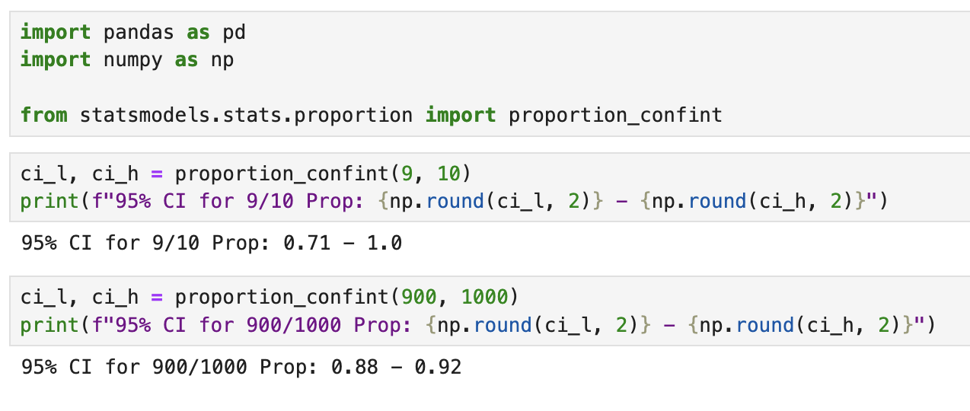
Sample Size - Statistical Power
Our first layer of uncertainty. Simply put is there a difference between:
9 / 10 predictions = 90% accuracy
900 / 1000 predictions = 90% accuracy
Both cases have identical accuracy but we have different levels of evidence
More data points = more certainty in our assessment
Can calculate confidence intervals using common statistical tests (in this case a binomial proportion CI)

Slide 18
Sample Size - Statistical Power

Slide 19
Model variability
Fold 1
Fold 2
Fold 3
As we saw last week:
Train a model multiple times
Get difference assessments each time
Can we capture the variability across models?
One common use for nested CV
Inner folds to optimize model
Outer fold to assess uncertainty
After completion of model assessment on CV:
Use the final test dataset to get a single unbiased estimate
From last week’s workshop, three Random Forest models:
Fold 1 Balanced accuracy: 80.4%
Fold 2 Balanced accuracy: 81.4%
Fold 3 Balanced accuracy: 80.6%
Each model was optimized on the inner fold splits

Slide 20

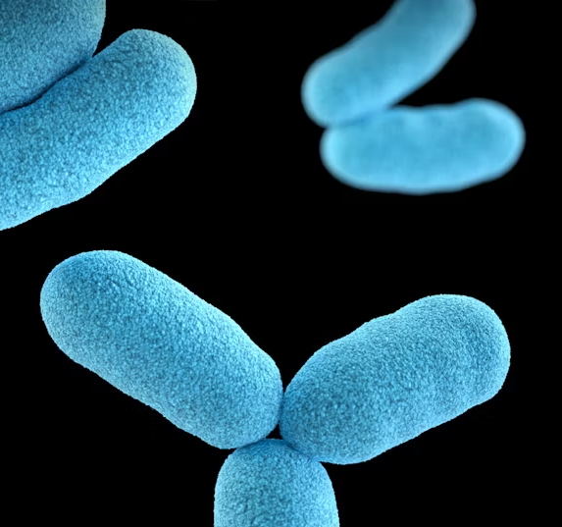
Generalizability
If we train here
More of an expert knowledge question
How representative is our data?
Will it work on new data?
Need to review and assess your dataset carefully, in our case:
Where did we get the E coli data from?
Was it geographically diverse or from one state?
Can we measure bacterial diversity? (Phylogeny)
Important to comment on your data collection!
Can we predict here?

Slide 21

Summary
Not always necessary to calculate everything out
BUT:
Vital to acknowledge and communicate uncertainty
If not in numbers then in words
For interviews/take-home exercises I’m always looking out for candidates that are aware of and acknowledge uncertainty:
Did they highlight places where they were unsure?
Did they list assumptions/questions?
Did they report any confidence levels?

Slide 22
Workshop 7
Performance Evaluation

